Slide 1
Unit – 6 E-Governance
Contents to be Covered:
Definition
Significance
Objectives
Various Programs by Indian Govt.
Digital India Program
Achievements by Indian Govt.

Slide 2
Definition of E-Governance
E-governance is the application of Information and Communication Technology (ICT) to government processes to improve public service delivery, transparency, and efficiency.
E-governance is the use of ICT, such as the internet and mobile computing, by government and public sector agencies to provide services, share information, facilitate transactions, and improve communication with citizens, businesses, and other government entities.
It goes beyond simply computerizing government operations, aiming to fundamentally change government processes to be more efficient and citizen-centric

Slide 3
Objectives of E-Governance
SMART Governance: To achieve a government that is Simple, Moral, Accountable, Responsive, and Transparent.
Improved Service Delivery: To make government services more accessible, efficient, and convenient by delivering them through digital platforms.
Increased Transparency: To provide information to the public in a transparent manner and reduce corruption by digitalizing processes.
Citizen Participation: To enhance citizen-government interaction by enabling online debates, e-participation, and digital democracy.
Efficiency: To streamline government functions, reduce paperwork, and lower administrative costs through automation and process re-engineering.

Slide 4
Significance of E-Governance
Reduced Corruption: Automating processes reduces the opportunities for corruption and bribery.
Lower Costs: Automation and reduced paperwork lead to significant cost savings for the government and taxpayers.
Increased Legitimacy: By being more transparent, accountable, and responsive, e-governance builds greater trust and legitimacy for government institutions.
Enhanced Accessibility: Citizens, especially in remote areas, gain easier access to government services and information.
Faster Communication: It creates faster and more efficient communication channels between government departments, businesses, and citizens.
Better Resource Management: Integrated systems and shared databases improve government planning, coordination, and execution.

Slide 5
E-Governance in India
E-Governance in India began as an administrative reform, evolving into a comprehensive system of public service delivery using technology.
It integrates departments, simplifies access to government benefits, and enables citizens to engage directly with the government. With major projects like Digital India (2015), India is transforming how citizens interact with the government at every level.
Through E-Governance, government functions are digitized to reduce manual intervention, minimize corruption, and improve accessibility. The idea reflects the broader national vision of “Minimum Government, Maximum Governance.”

Slide 6
E-Governance in India
The National e-Governance Plan (NeGP) launched in 2006, laid the foundation for digital public services.
Later, the Digital India Mission (2015) expanded this vision by connecting villages, enabling digital transactions, and ensuring that every citizen could access government services online.
According to the Ministry of Electronics and Information Technology (MeitY), E-Governance in India now covers more than 31 Mission Mode Projects (MMPs), including areas like income tax filing, land records, passports, pensions, and rural development.

Slide 7
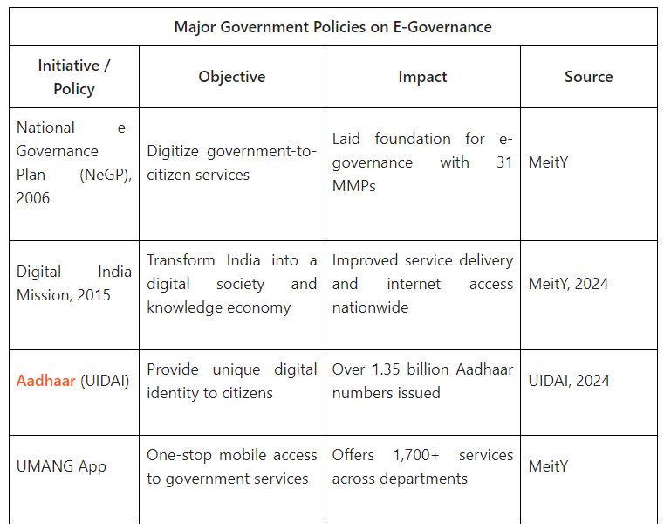

Slide 8
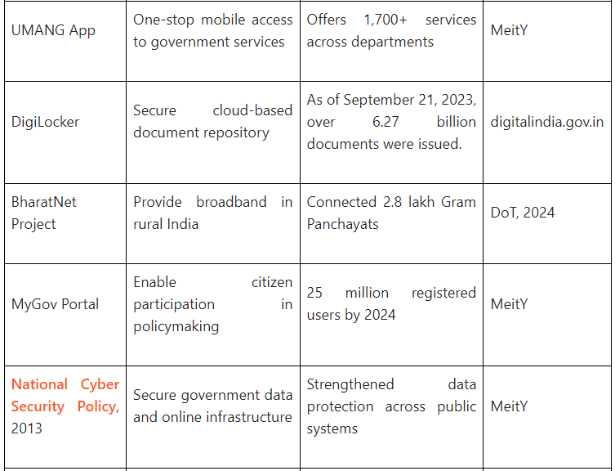

Slide 9
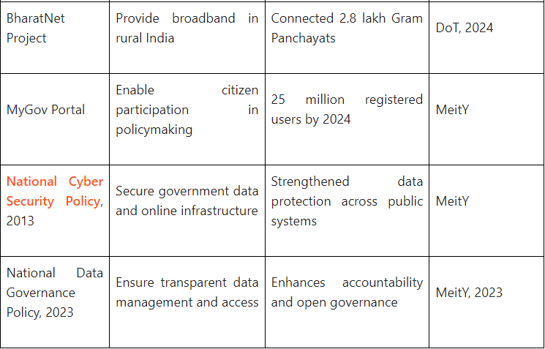

Slide 10
Digital India Mission/Pillars of E-
Governance
E-Governance in India rests on several pillars that provide the foundation for digital transformation.
As per the Digital India Mission, nine pillars define the structure of e-Governance. Each one addresses a crucial part of the country’s digital ecosystem.
Ten years ago, India launched Digital India Mission to democratize technology access.
The mission has achieved remarkable success—internet connections grew from 250 million to 970 million, UPI processes 100+ billion transactions annually, and Direct Benefits Transfer has saved ₹3.48 trillion while empowering MSMEs nationwide.
Digital India has evolved from a government program into a people's movement, fundamentally transforming governance, commerce, and daily life across the nation.

Slide 11
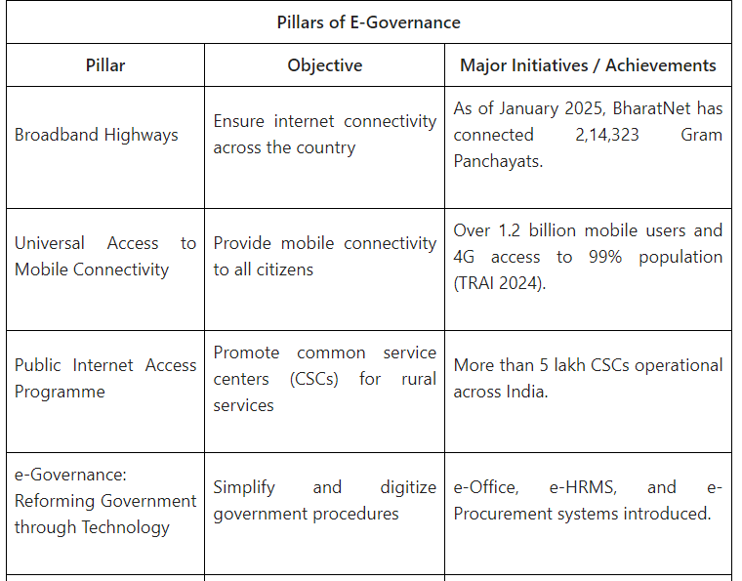

Slide 12
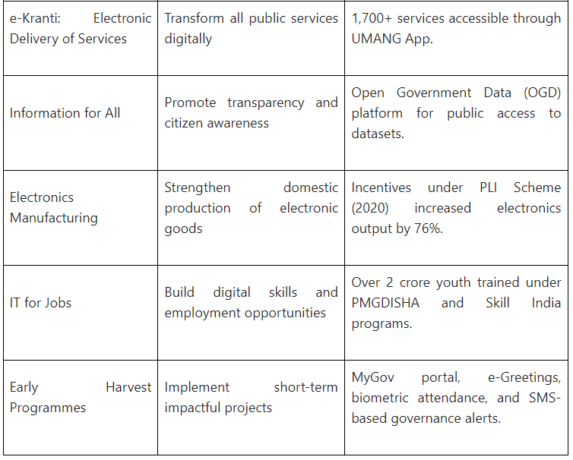

Slide 13
Impact of E-Governance in India
The digital transformation of government processes has had a deep impact on India’s socio-economic landscape. E-Governance has improved the speed, transparency, and inclusiveness of service delivery.
Key Impacts are:
Improved Transparency: Portals like RTI Online and MyGov promote open government and citizen feedback.
Financial Inclusion: Through Jan Dhan-Aadhaar-Mobile (JAM) Trinity, over 47 crore people have gained access to formal banking.
Ease of Doing Business: Online filing, e-Procurement, and GSTN systems have simplified compliance.
Social Inclusion: Schemes and subsidies reach citizens directly through DBT, reducing leakages.
Education and Health: Platforms like DIKSHA and Ayushman Bharat Digital Mission provide online access to essential services.
Rural Connectivity: BharatNet and CSCs ensure last-mile digital delivery.
Environmental Benefits: Paperless offices and e-documents reduce administrative waste.

Slide 14
E-Governance in India Achievements
These following achievements demonstrate how E-Governance has shifted India’s administrative framework toward inclusivity and efficiency.
As of October 2024, BharatNet connected 2,14,283 Gram Panchayats, falling short of the targeted 2,22,343. (PIB)
As of September 2023, DigiLocker had issued over 6.27 billion documents to over 196 million users
As of August 2025, the Pradhan Mantri Jan Dhan Yojana (PMJDY) had opened over 53 crore accounts.
In August 2025, UPI recorded 20.01 billion transactions amounting to ₹24.85 lakh crore.
India’s E-Government Development Index (EGDI) rank is 97 out of 193 countries
As of October 2024, over 5.84 lakh Common Services Centres (CSCs) were operational across the country, including 4.63 lakh at the Gram Panchayat level.
Tripura’s West Majlishpur Gram Panchayat: Awarded second place in the 2024-2025 e-Governance awards for grassroots-level service delivery.
Suakati Panchayat, Odisha: Honored with the ‘Jury Award’ at the National Awards for e-Governance 2025 for leveraging technology in public service delivery.

